Slide 1
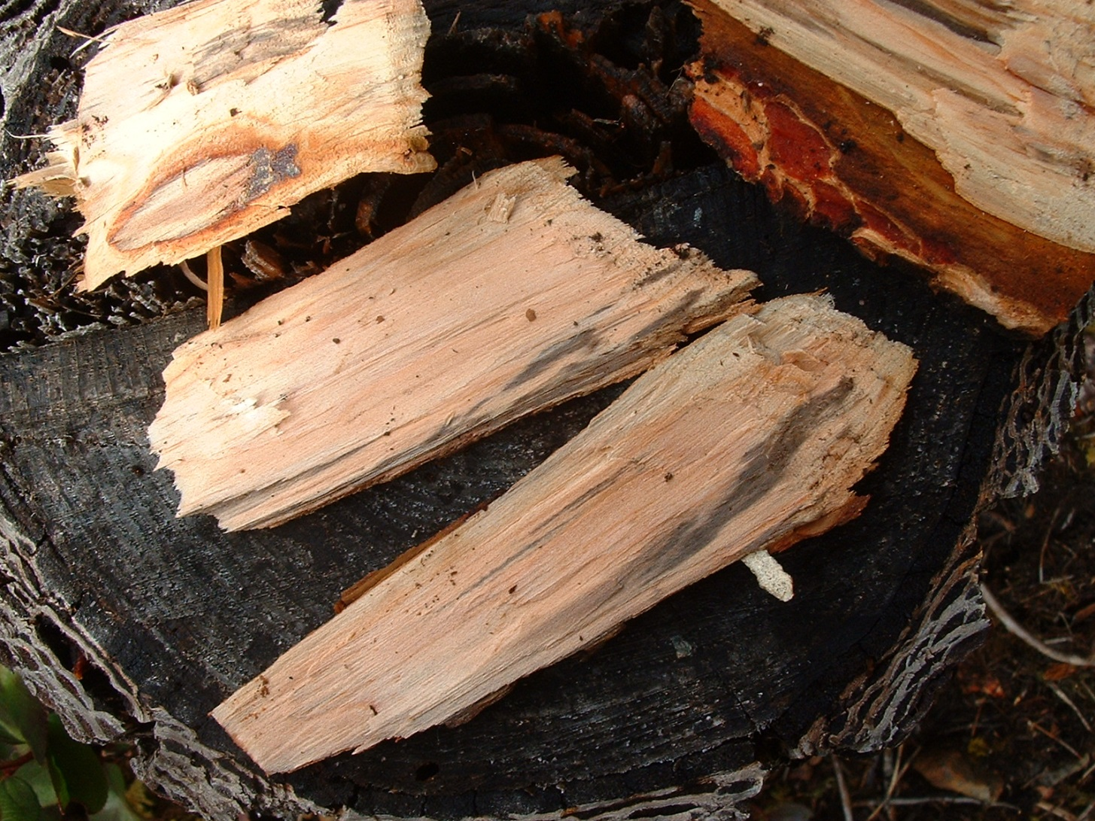
David Rusch Regional Pathologist Cariboo and Thompson Okanagan
Black Stain

Slide 2
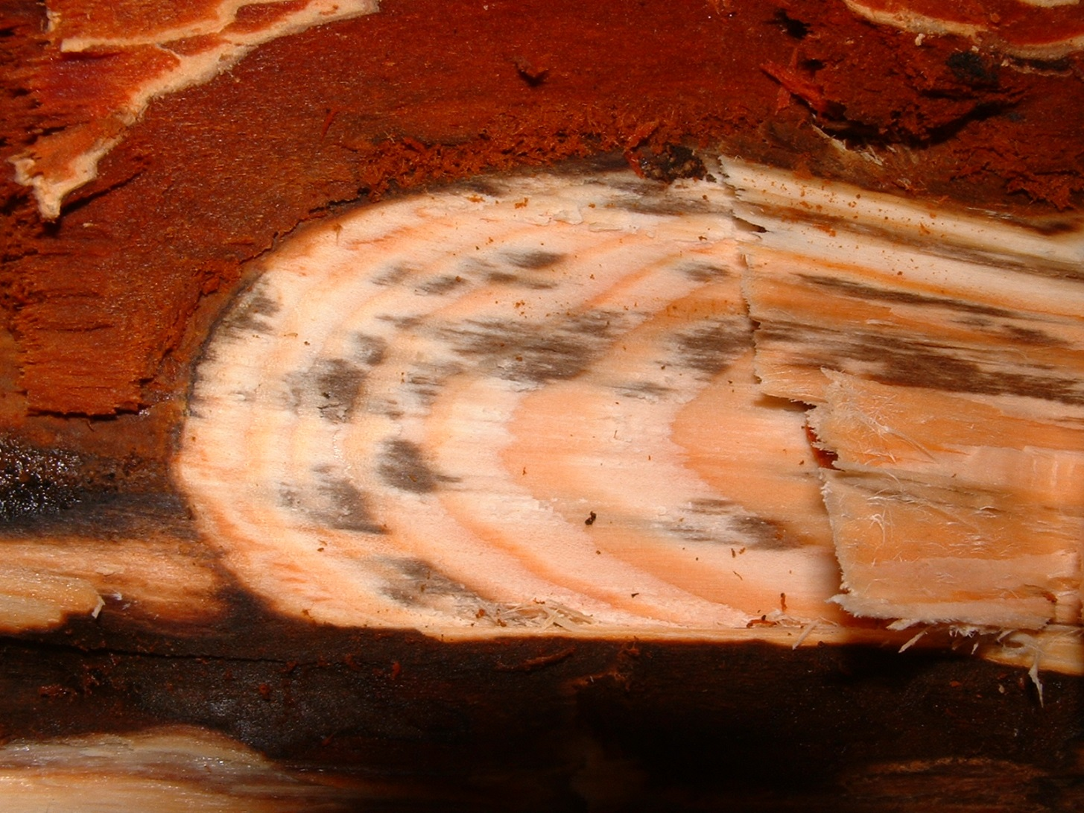

Slide 3
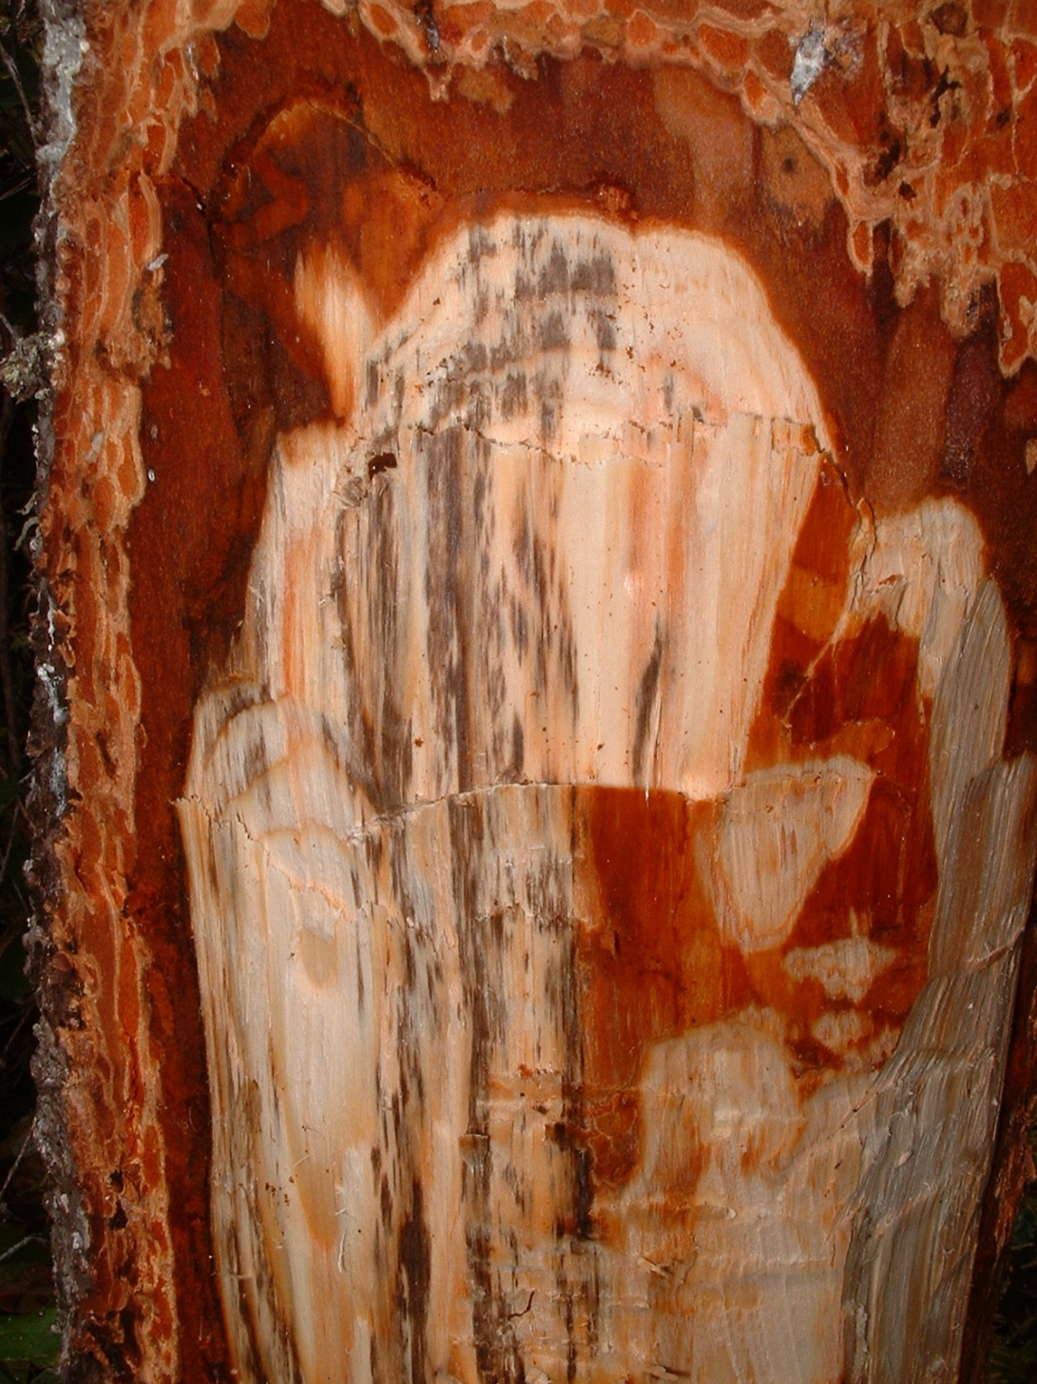
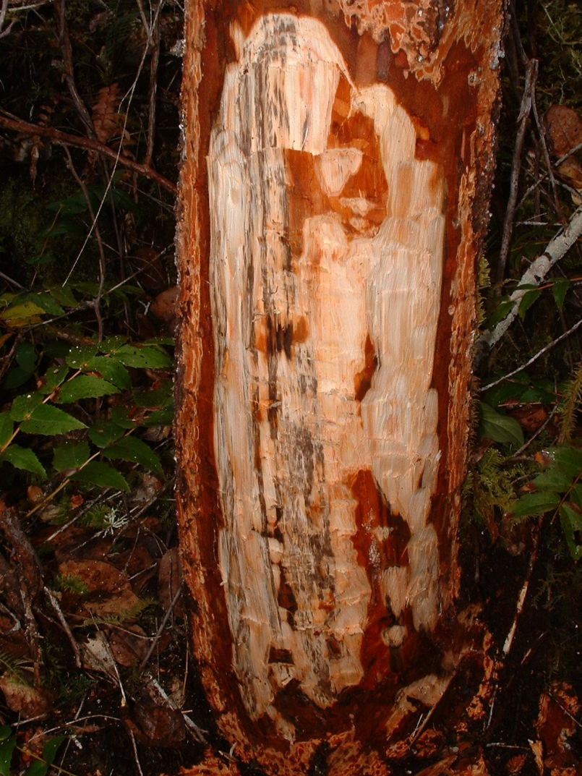

Slide 4
Leptographium wagenerii imperfect stage
Ceratocystis wagenerii perfect stage
Not a decay fungus
Similar to blue stain but brown or black in colour
Clogs up tracheids
Vectored by secondary insects including weevils (Steremnius and Pissodes spp.) and root bark beetles (Hylastes and Hylurgops spp.)
Douglas-fir type (all ages but more prevalent in younger trees)
hard pine type (usually pine over 20 years)
also pinyon pine variety in U.S.
Associated with road disturbance or soil compaction, flood stressed trees and areas with root rot or bark beetle infected trees that attract secondary insects

Slide 5
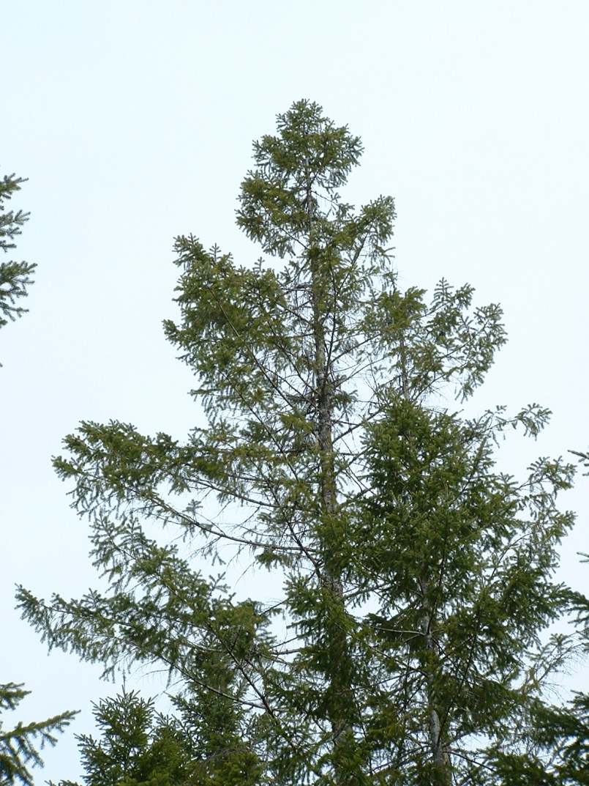
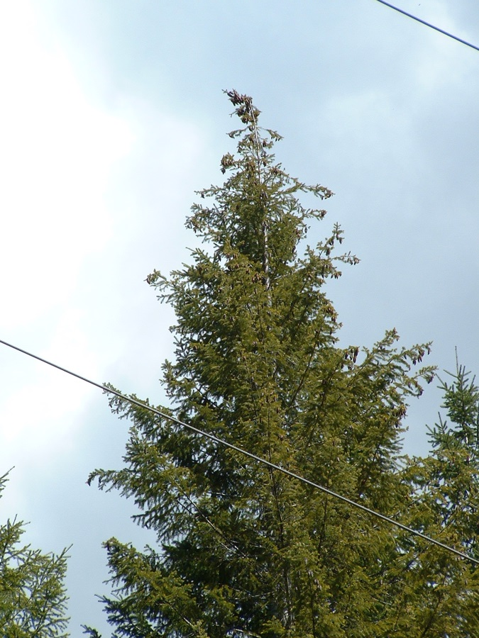
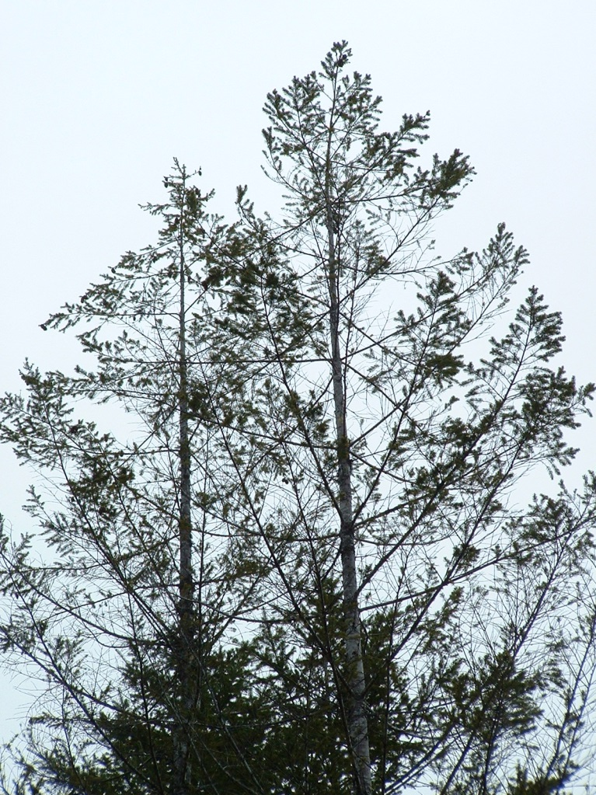
Symptoms same as for other root diseases

Slide 6
Most unrecognized root disease
need to cut into wood to see it
Stain fades within one or two years of death (look for recently killed trees)
Can spread quickly by root to root contact but likely doesn’t persist in centers for extended time periods
Pine type has been found associated with shallow soils in Cariboo
Will likely become more important in the future

Slide 7
spread
Spread by conidiophores (stalked fruiting bodies) that emit droplets of sticky spores that are transferred to secondary insects
Enters through wounds that attract secondary insects or may in some cases be caused by secondary insect feeding

Slide 8
Treatment
Treatments focus on reducing conditions that favour secondary insects (creation of slash and stressed trees)
Time stand entries for when insects are not flying and trees and slash have time to dry out before spring (mid- late summer) and try to limit the number of consecutive entries in the same block or area
“Working down the road” can provide a constant food supply over time as insects move from block to block
Mixed plantings can reduce root to root spread

